Slide 1




a jump-start for .NET developers
presented by Bryan Hunter Firefly Logic
Twitter #ndcoslo #erlang @bryan_hunter
@fireflylogic
Notes:
A team of C# and Erlang developers is a force to be reckoned with because Erlang and .NET are pure complements— each excels at what the other sucks at. Many C# developers write both JavaScript and SQL; adding Erlang to the mix can (and should) be just as natural.
But wait, what is Erlang? Erlang is an industry-proven, open-source, cross-platform, functional programming language and runtime. Facebook's chat, CouchDB, RabbitMQ, GitHub's pages, Opscode Chef, Riak, and Amazon's SimpleDB are all written in Erlang for good reason— Erlang simplifies writing highly-reliable, concurrent, distributed systems.
How does a C# developer even get started?
What are the development tools?
Can it all be done on Windows?
What is similar, and what is truly foreign?
What baggage does a good C# developer bring to Erlang?
How do you begin to lose your C# accent?
When is Erlang the right tool for the job?
How should a .NET shop pilot Erlang?
Come learn the "what", "why" and "how" of Erlang and get started!

Slide 2
?

Slide 3
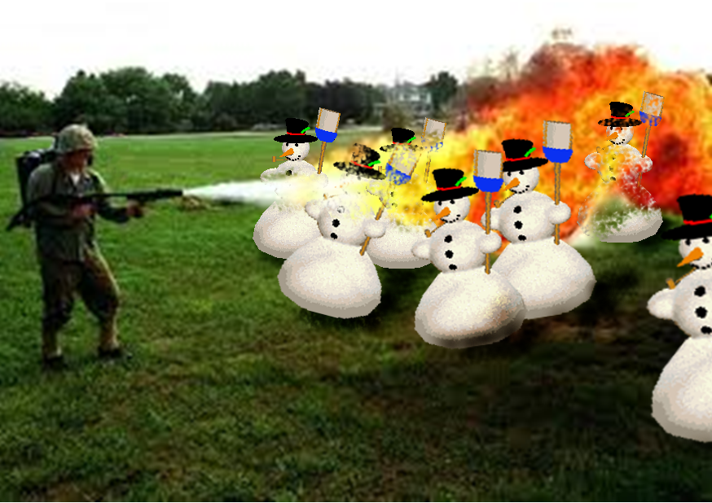
Right tool for the job!

Slide 4
What’s Erlang?
Erlang (the language)
+
OTP
+
The ERTS
(Erlang Runtime System)

Slide 5
Erlang (the Language)
Functional
immutability, higher-order functions, referential transparency, separation of behavior and data, recursion,
Concurrency- oriented
Different model of the world
Prolog roots
Pattern matching

Slide 6
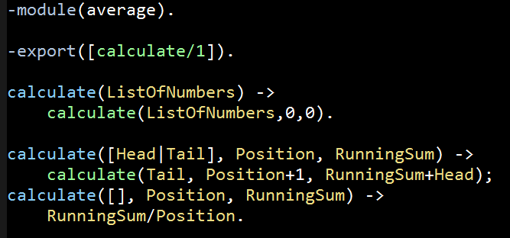
Erlang (the Language)
File: average.erl

Slide 7
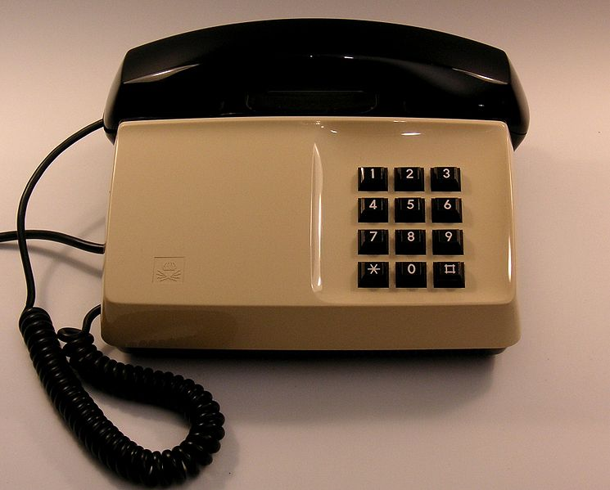
OTP

Slide 8
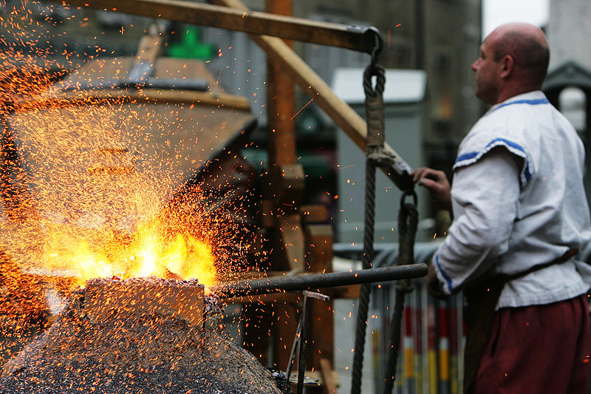
OTP
Erlang Runtime System

Slide 9
Erlang Runtime System (in-context)
.NET dev stack
Erlang dev stack
C# / F#
Erlang / Elixir / Joxa
.NET Framework
OTP
CLR
ERTS
VM + Kernel
+ STDLIB
OS (Windows)
OS (Windows, Linux, Mac, None)

Slide 10
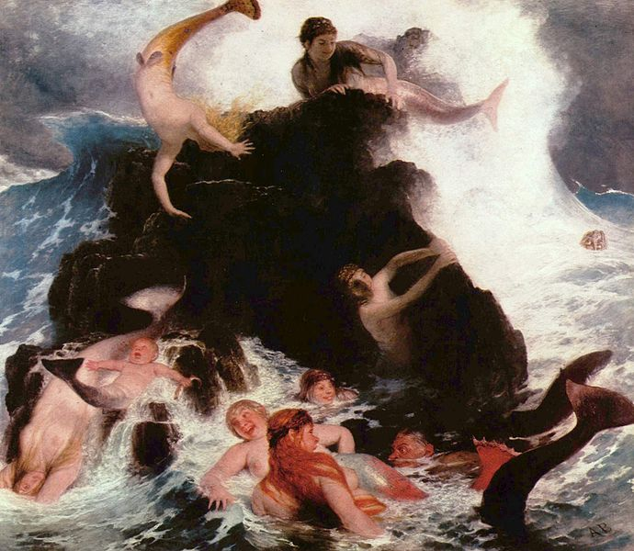

Any sufficiently complicated concurrent program in another language contains an ad hoc informally-specified bug-ridden slow implementation of half of Erlang.

Slide 11
Erlang in less than 140 characters
Erlang is open, proven and cross-platform. It simplifies writing reliable, concurrent, distributed systems. Its pattern matching is FTW.

Slide 12
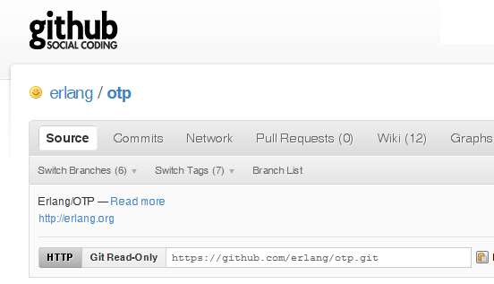

Why -> Erlang is open

Slide 13
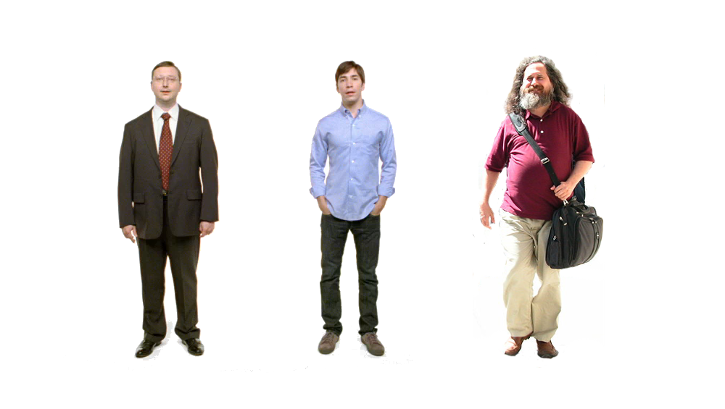
Erlang
Erlang
Erlang
Why -> Erlang is cross-platform

Slide 14


















Why -> Erlang is proven
Notes:
Ericsson: switches and Mobile base stations. In its support nodes, used in GPRS and 3G mobile networks worldwide.
T-Mobile: SMS and authentication systems
Amazon: SimpleDB, unconfirmed DynamoDB
Facebook: chat
Yahoo! with social bookmarking service Delicious (5 million users and 150 million bookmarks)
Motorola: call processing products in the public-safety industry

Slide 15
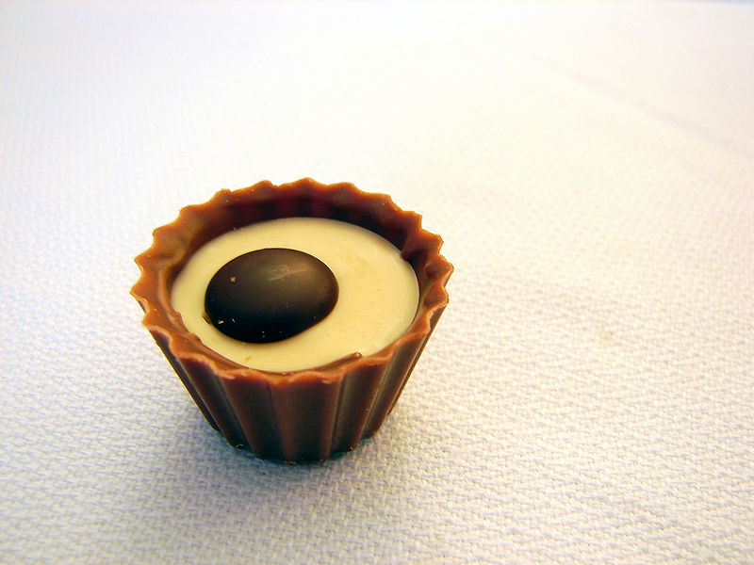
What are the sweet spots?

Slide 16
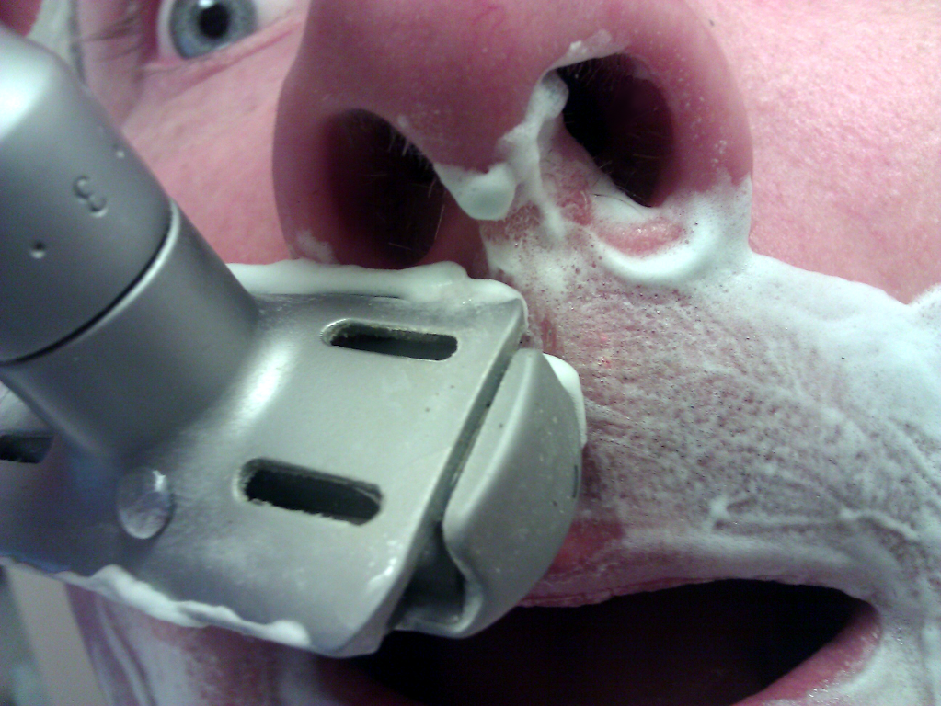
Why -> elsewhere concurrency is painful

Slide 17
Two thing to remember about
Concurrency
1) Shared memory concurrency is hard
2) Message passing concurrency is easy

Slide 18
“The performance
of a concurrent language
is predicated by three things:
the context switching time,
The message passing time,
and the time to create a process.”
–Mike Williams

Slide 19
Erlang Processes
are the unit of concurrency.
You structure your programs around these units of concurrency.

Slide 20
One .NET 4.0 Thread (allocates one megabyte)
**********
**********
**********
**********
**********
**********
**********
**********
**********
**********
**********
**********
**********
**********
**********
**********
**********
**********
**********
**********
**********
**********
**********
**********
**********
**********
**********
**********
**********
**********
**********
**********
**********
**********
**********
**********
**********
**********
**********
**********
**********
**********
**********
**********
**********
**********
**********
**********
**********
**********
Heap
Mailbox
Stack
**********
**********
**********
**********
**********
**********
**********
**********
**********
**********
**********
**********
**********
**********
**********
**********
**********
**********
**********
**********
**********
**********
**********
**********
**********
**********
**********
**********
**********
**********
**********
**********
**********
**********
**********
**********
**********
**********
**********
**********
**********
**********
**********
**********
**********
**********
**********
**********
**********
**********
Garbage Collector
Links and Monitors
One Erlang Process (allocates one kilobyte)
*
Why -> elsewhere concurrency is painful

Slide 21
*
*
*
Reductions
- Do 2,000 operations
reduction1 reduction3 .
Reduction2000
- Move to the next guy - Repeat
CPU Core
Why -> near zero context switching cost

Slide 22
worker
supervisor
*
*
CPU Core
Why -> supervision

Slide 23
***** *****
***** *****
***** *****
***** *****
Core
Core
Core
Core
Why -> elsewhere concurrency is painful

Slide 24

Distribution: built-in from the start

Slide 25

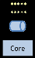
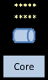
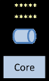
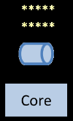
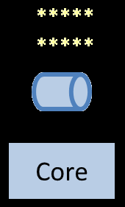
Distribution: built-in from the start

Slide 26
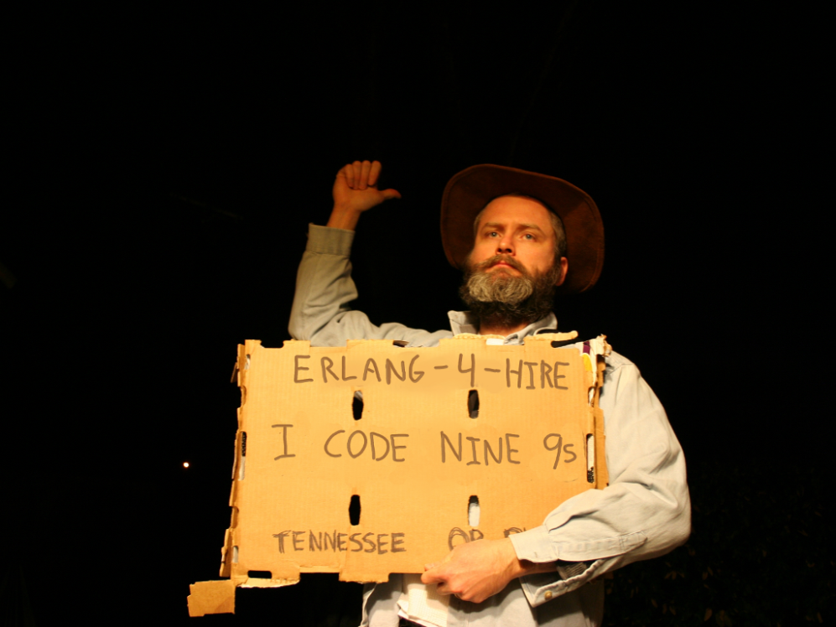
Nines | Uptime | Annual Downtime
9 | 99.9999999% | 30 milliseconds
8 | 99.9999990% | 300 milliseconds
7 | 99.9999900% | 3 seconds
6 | 99.9999000% | 32 seconds
5 | 99.9990000% | 5 minutes
4 | 99.9900000% | 53 minutes
3 | 99.9000000% | 8 hours, 46 minutes
2 | 99.0000000% | 3 days, 15 hours, 36 minutes
Safe
Supervisor
Worker
Worker
Links and monitors
No masters
Hot code loading
simple distribution, safe concurrency
Why -> reliability

Slide 27
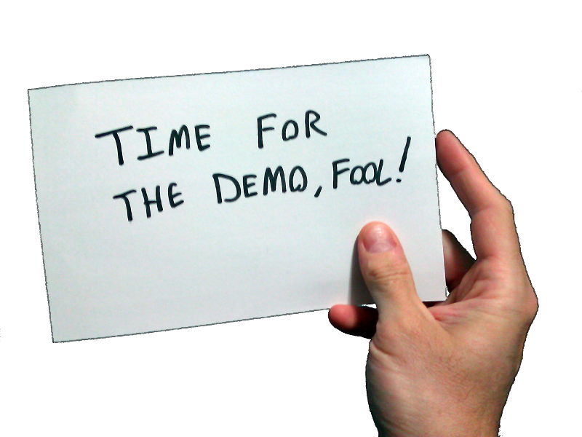
Erlang!
What exactly is Erlang?
Why Erlang?
How do you do it?
In the shell
In a text editor + command line + shell
In Emacs

Slide 28
[insert awe-inspiring demos here]

Slide 29


Slide 30
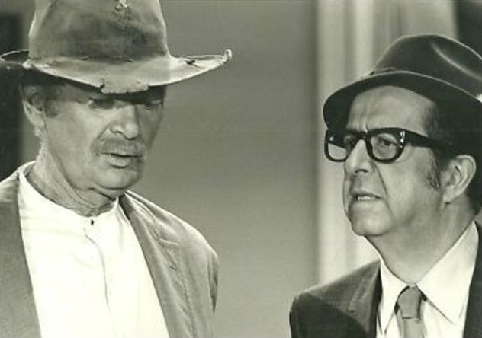
How do you begin to lose your C# accent?
View immutability as your friend
Stop hording state
Begin to use higher-order functions
Replace conditional logic with pattern matching
Begin to think recursively and replace loops with recursion
Start teasing out behavior from data

Slide 31
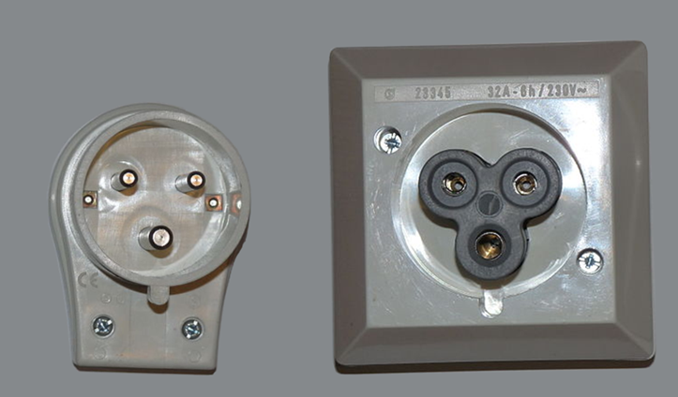
What are the best interop strategies?
Pssst, pssps…spsss.
You want to put what? where!?

Slide 32
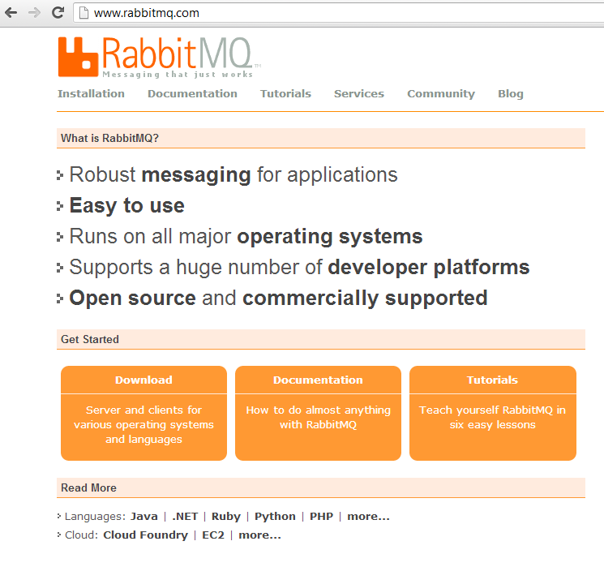
What are the best interop strategies?
Web Server (Cowboy, Webmachine, Yaws, …)
Sockets
JSON, Protobuf, …
OTP.NET

Slide 33

How to pilot Erlang?

Slide 34
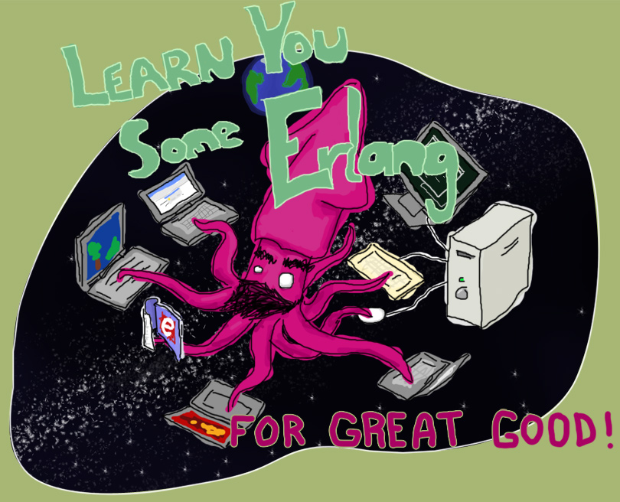
“Learn You Some Erlang for Great Good!” http://learnyousomeerlang.com/
How -> read this excellent and free online book

Slide 35



Start here
How -> read some books

Slide 36
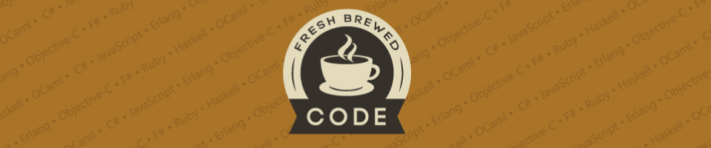
My blog:
http://freshbrewedcode.com/bryanhunter/
How -> visit my blog

Slide 37
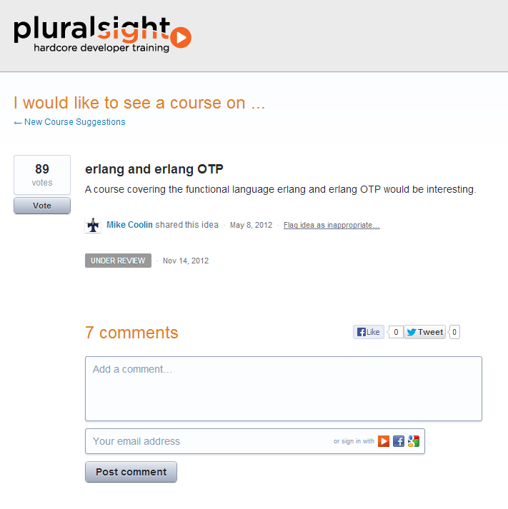
How -> Nag Pluralsight

Slide 38

http://erlangcamp.com
How -> Two day intense hands-on training

Slide 39

http://nashfp.org
How -> Better yet; pack up and move to Nashville!

Slide 40
Bryan Hunter
Twitter: @bryan_hunter
Email: bryan.hunter@fireflylogic.com
Blog: codeswamp.com
Firefly Logic, Inc.
1000 Main Street, Suite 201 Nashville, TN 37206
http://fireflylogic.com
How -> keep in touch

